Slide 1







SangLehar FitnessFlow
Gym Fitness Management
A Comprehensive Platform for Membership, Workouts, and Administration
Presented By:
Sangita Rawlo (107223504043)
Leharika.k (107223504014)

Slide 2


SangLehar FitnessFlow
Contents
Abstract
Introduction
Modules
Requirements
UML Diagrams
Features
Conclusion

Slide 3


SangLehar FitnessFlow
Abstract
The Gym Fitness Management System is a web-based application developed using Django (Python), HTML5, CSS, JavaScript, and MySQL, aiming to modernize gym operations by digitizing every manual task. The project provides a centralized platform for administrators, trainers, members, and guests to interact with various gym-related activities efficiently.
The system allows administrators to manage gym memberships, attendance, products, payments, and fitness content, while trainers can create and assign personalized workout schedules and diet plans for members. Members can access these plans, track attendance, shop for gym products, and engage with fitness blogs and videos. Additionally, guests can explore the platform and seamlessly register for gym memberships.

Slide 4
SangLehar FitnessFlow
Abstract
Key functionalities include automated attendance tracking, membership plan management, product purchases, feedback collection, and comprehensive reporting with advanced filters. The database is designed with structured tables to manage users, memberships, workouts, and payments effectively.
By replacing traditional manual methods, this system significantly improves efficiency, reduces operational complexity, and enhances user engagement. The platform’s scalability and user-friendly interface make it a valuable tool for gym owners, trainers, and members, fostering an integrated fitness ecosystem.

Slide 5




SangLehar FitnessFlow
Introduction
A Gym Fitness Management System is a software application designed to streamline and automate the daily operations of a gym or fitness center. It enhances efficiency by managing memberships, payments, class schedules, trainer assignments, and overall facility administration.
Key Features
Benefits
Membership Management
Efficiency
Billing & Payments
Improved Customer Experience
Class & Trainer Scheduling
Financial Tracking
Inventory & Equipment Management
Data Security
Reporting & Analytics

Slide 6



SangLehar FitnessFlow
Modules
Admin Module
The Admin Module is the backbone of the system, providing comprehensive management capabilities for all aspects of the gym's operations. It is designed for the gym owner or staff with administrative privileges.
Trainer Module
The Trainer Module is designed for gym trainers, allowing them to manage members' fitness activities and track their progress.
Memeber Module
The Member Module focuses on providing gym members with a personalized experience and tools to track their fitness journey.
Guest Module
The Guest Module is for individuals who are not yet members but are exploring the gym's offerings. It allows potential members to interact with the platform to a limited extent.

Slide 7



SangLehar FitnessFlow
System Requirements
System Configuration Required:
Operating System: Windows/Linux/MacOS
Processor: Intel i3 or higher
RAM: 4GB or above
Storage: 20GB free space
Browser: Chrome, Firefox, or Edge
Software Required:
Frontend: HTML5, CSS 2.1, JavaScript
Backend: Python 3.8 with Django 3.1
Database: MySQL 5.5

Slide 8



SangLehar FitnessFlow
UML Diagrams
Class Diagram
ER Diagram
Activity Diagram
Sequence Diagram
Data Flow Diagram
Use Case Diagram

Slide 9

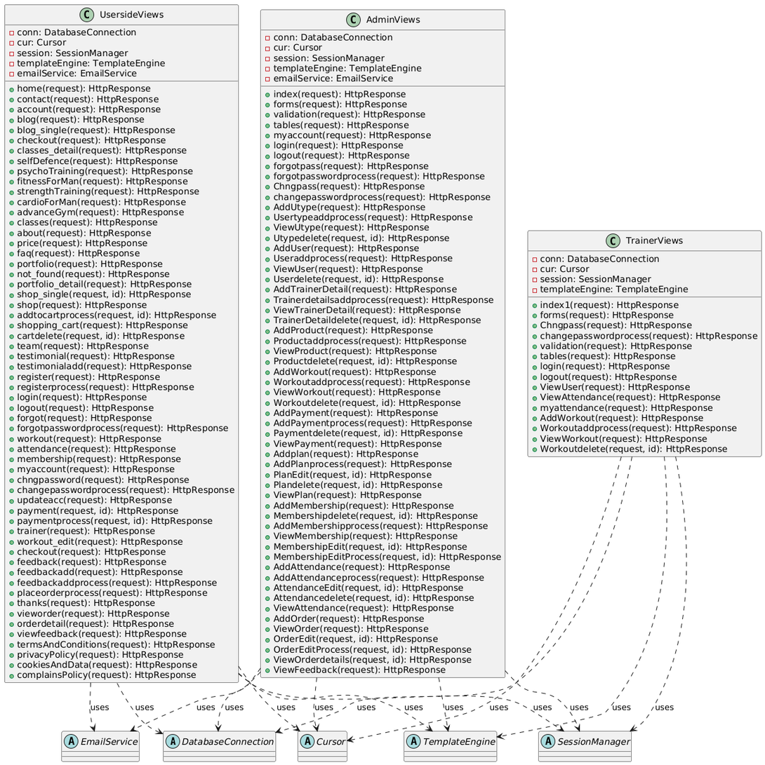
SangLehar FitnessFlow
Class Diagram

Slide 10
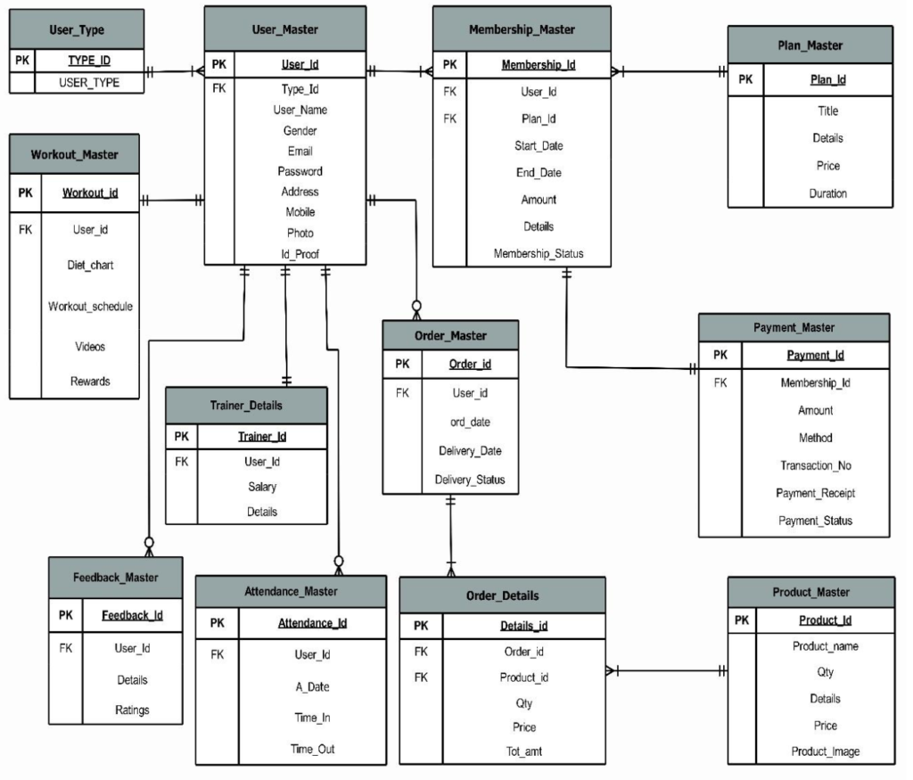
SangLehar FitnessFlow
Entity Relationship Diagram

Slide 11
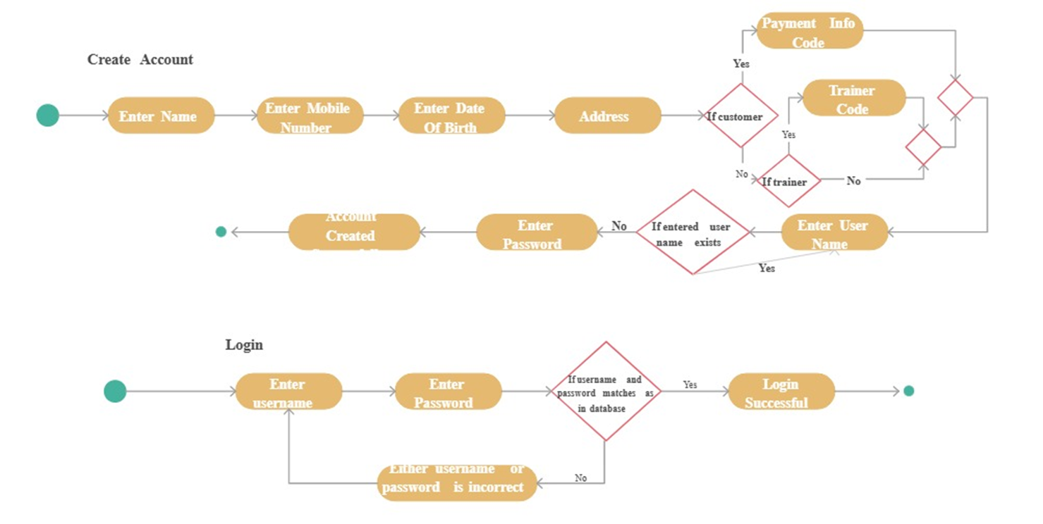
SangLehar FitnessFlow
Activity Diagram

Slide 12
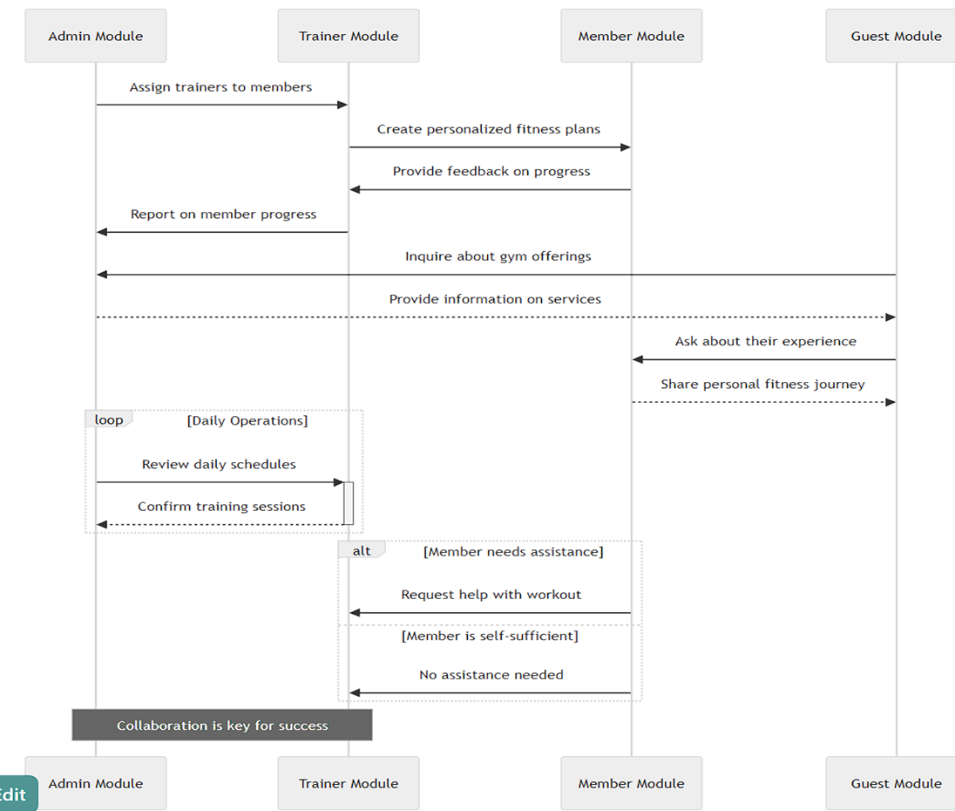
SangLehar FitnessFlow
Sequence Diagram

Slide 13
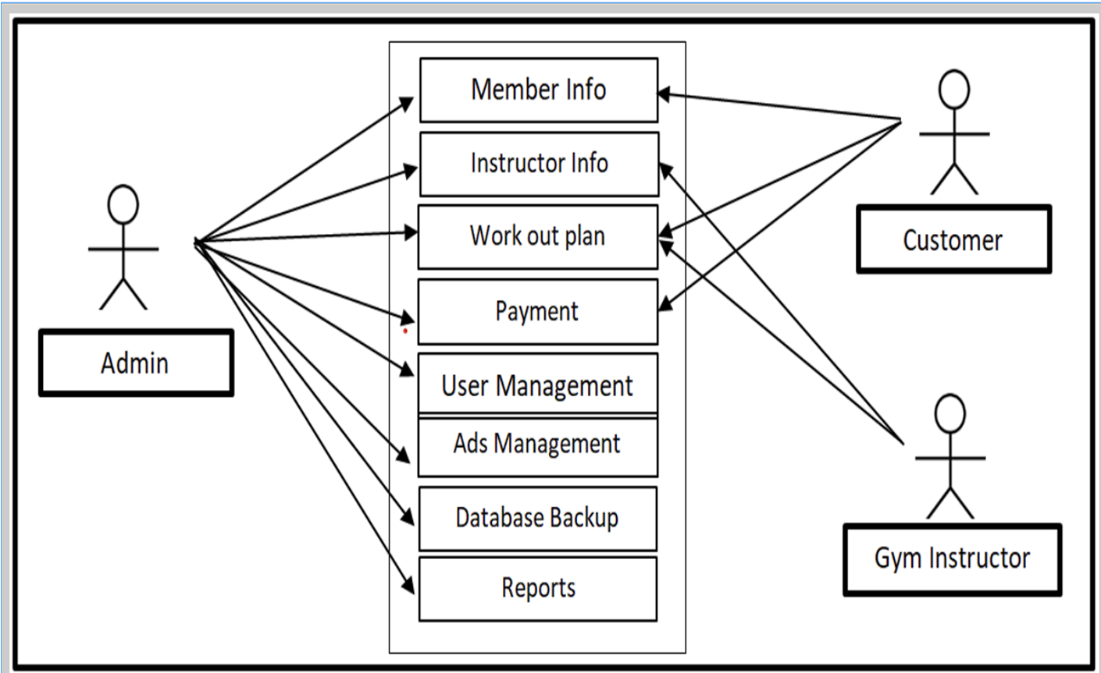
SangLehar FitnessFlow
Use Case Diagram

Slide 14
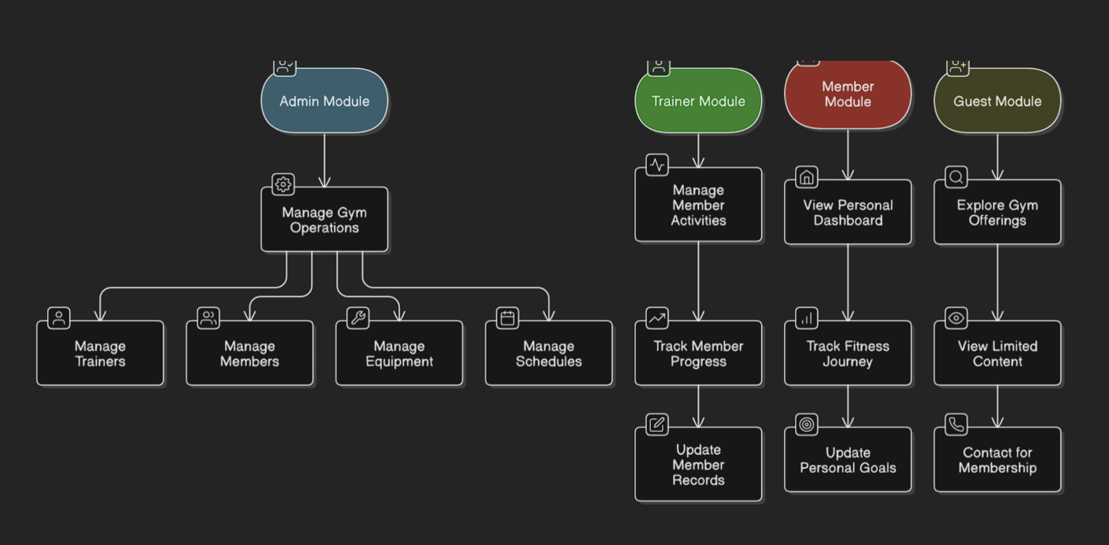
SangLehar FitnessFlow
Data Flow Diagram

Slide 15
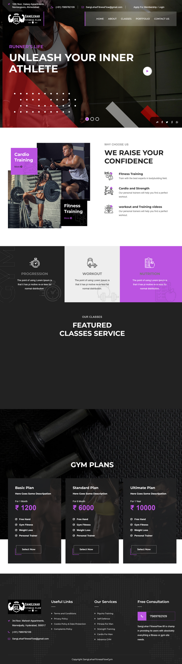

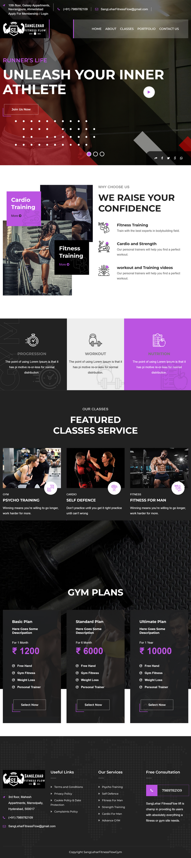
SangLehar FitnessFlow
Interfaces
Responsive interface optimized for all screen sizes, including:
Laptop screens
iPhone 14 Pro Max
iPad Pro

Slide 16

SangLehar FitnessFlow
Conclusion
The Gym Fitness Management System streamlines and automates gym operations, replacing manual processes with a digital solution. It enhances the management of members, trainers, attendance, memberships, payments, and workouts while providing a user-friendly experience.
Built with Django, MySQL, HTML5, CSS, and JS, the system ensures reliability, scalability, and efficiency. Features like online membership, payment management, workout tracking, and reports improve engagement and decision-making.
Overall, this system boosts efficiency, reduces errors, and enhances user experience, making it a valuable tool for modern gym management.

Slide 17
SangLehar FitnessFlow
Thank You!
We appreciate your interest in our Gym Fitness Management System and its impact on modern gym operations.
For any questions or discussions, feel free to ask.
Looking forward to your feedback! 😊
SangLeharFitnessFlow@gmail.com

